Slide 1
EVENT BUBBLING

Slide 2
Event Bubbling
events ripple and affect a bunch elements that lie in their path

Slide 3
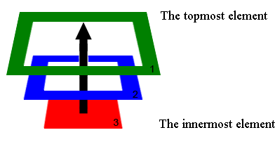
Event Bubbling
The bubbling guarantees that click on Div 3 will trigger onclick first on the innermost element 3
(also called the target), then on the element 2, and the last will be element 1.

Slide 4
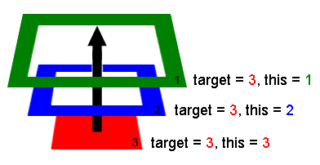
The deepest element which triggered the event is called the target or, the originating element.
When handlers trigger on parents:
event.target/srcElement - remains the same originating element.
this - is the current element, the one event has bubbled to, the one which runs the handler.

Slide 5
<body id="theBody" class="item">
<div id="one_a" class="item">
<div id="two" class="item">
<div id="three_a" class="item">
<button id="buttonOne" class="item">one</button>
</div>
<div id="three_b" class="item">
<button id="buttonTwo" class="item">two</button>
<button id="buttonThree" class="item">three</button>
</div>
</div>
</div>
<div id="one_b" class="item">
</div> </body>

Slide 6
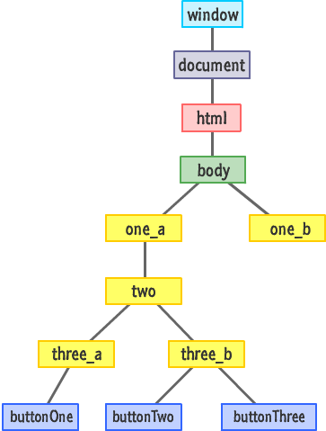

Slide 7
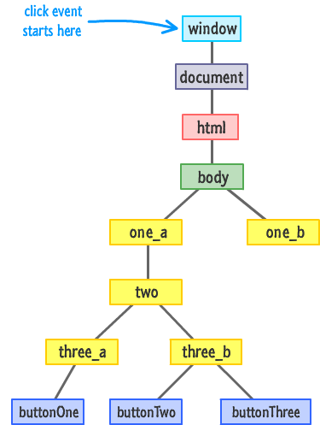

Slide 8
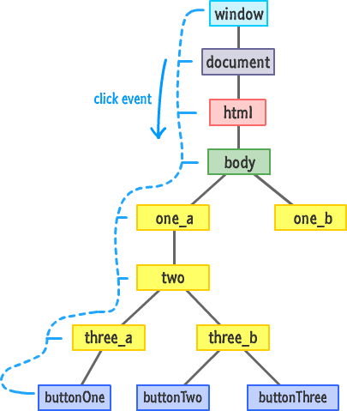

Slide 9
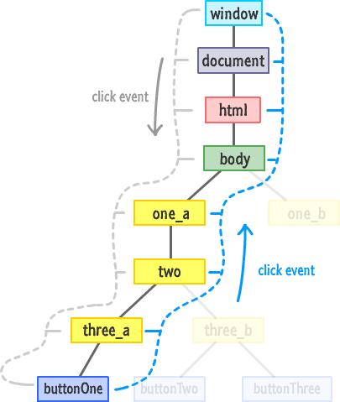

Slide 10
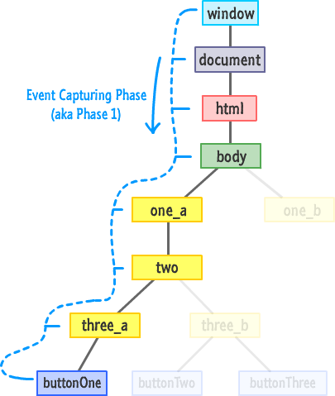

Slide 11
